Slide 1
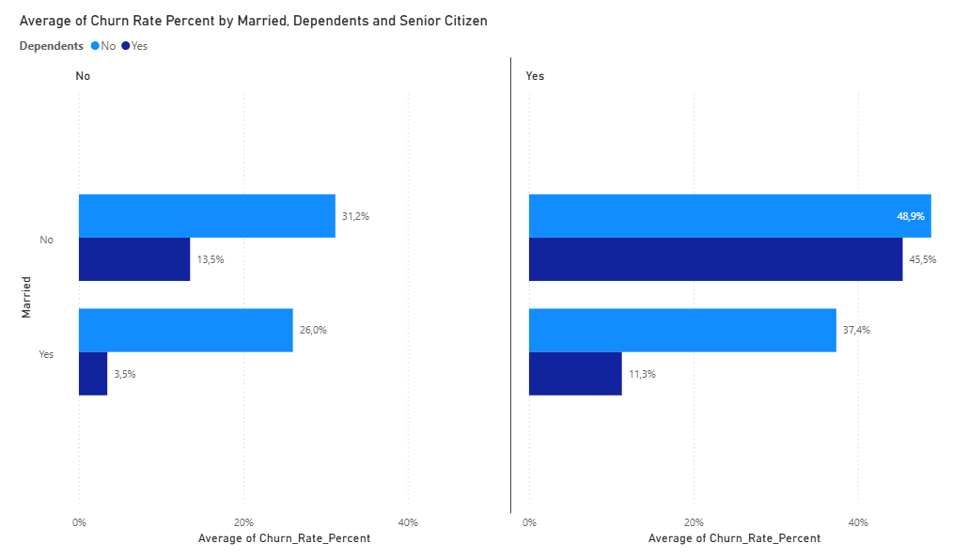
Reducing Customer Churn for an TELCOM
► The highest risk of churn is concentrated among single retirees with no dependents (Senior Citizen = Yes, Married = No, Dependents = No) - their churn rate reaches 48.9%. At the same time, non-retired customers with children demonstrate the highest loyalty, with a churn rate of just 3.5%.
link

Slide 2
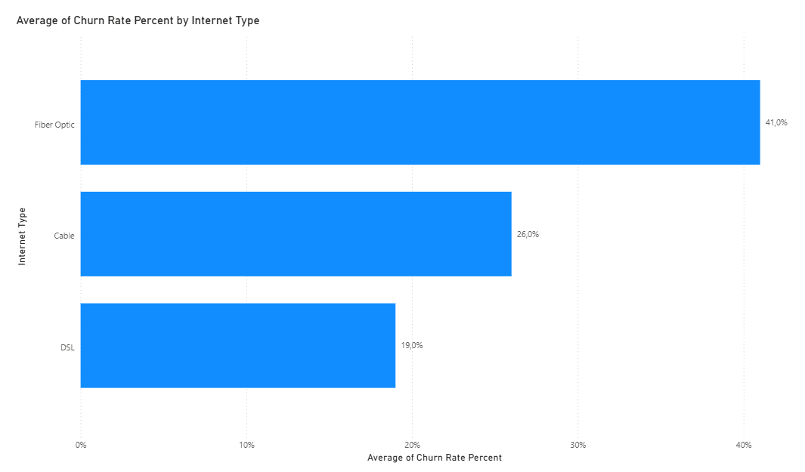
Demographic churn portrait
► Fiber-optic connections have the highest churn rate - 41%. This is more than twice as high as that of DSL users (19%).
► The problem most likely lies in the cost of fiber-optic plans, the stability of the fiber-optic connection, or the quality of service for this type of internet
connection.
► The highest risk of churn is concentrated among single retirees with no dependents (Senior Citizen = Yes, Married = No, Dependents = No) - their churn rate reaches 48.9%. At the same time, non-retired customers with children demonstrate the highest loyalty, with a churn rate of just 3.5%.

Slide 3
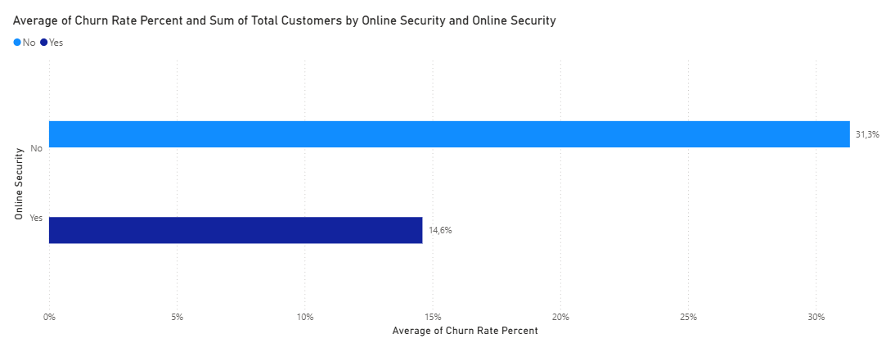
Analysis of the Product Portfolio and Service Quality: INTERNET
► The availability of the Online Security add-on service reduces customer churn by more than half—from 31.3% to 14.6%.
► Fiber-optic connections have the highest churn rate - 41%. This is more than twice as high as that of DSL users (19%).
► The problem most likely lies in the cost of fiber-optic plans, the stability of the fiber-optic connection, or the quality of service for this type of internet
connection.

Slide 4
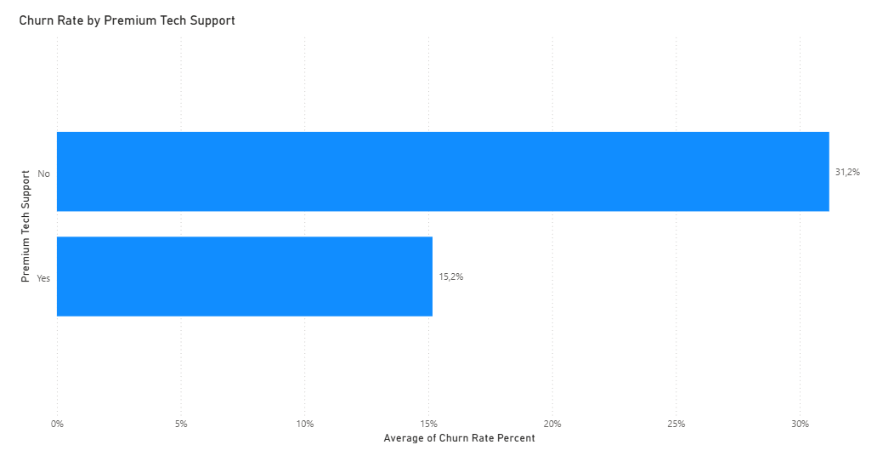
Analysis of the Product Portfolio and Service Quality: ONLINE SECURITY
► Churn WITHOUT the service: 31.19%
► Churn WITH the service: 15.17% (churn is less than half!)
► The availability of the Online Security add-on service reduces customer churn by more than half—from 31.3% to 14.6%.

Slide 5
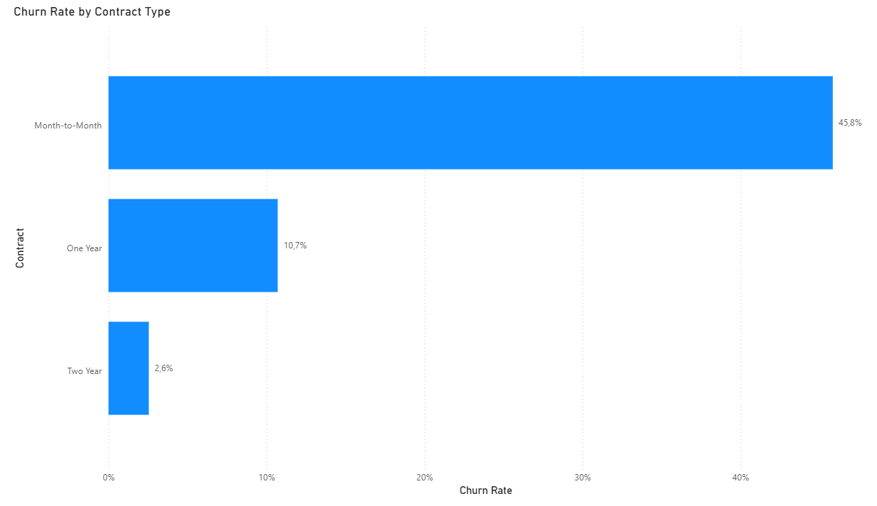
Analysis of the Product Portfolio and Service Quality: PREMIUM TECH SUPPORT
► The contract type is the main driver of customer retention.
► Customers on a monthly payment plan churn in 45.8% of cases.
► Switching a customer to a 1-year contract reduces the risk of churn by a factor of 4.3 (to 10.7%).
► A 2-year contract virtually eliminates churn (2.6%).
► Churn WITHOUT the service: 31.19%
► Churn WITH the service: 15.17% (churn is less than half!)

Slide 6
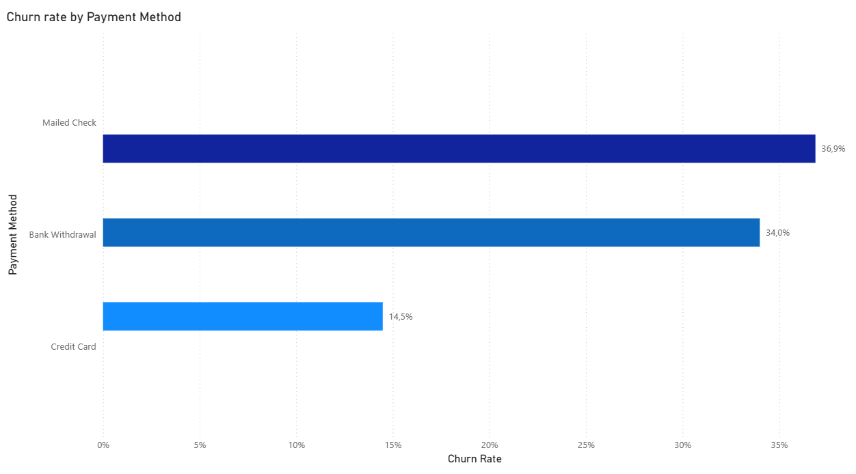
Financial & Contract Churn: CONTRACT TYPE
► The contract type is the main driver of customer retention.
► Customers on a monthly payment plan churn in 45.8% of cases.
► Switching a customer to a 1-year contract reduces the risk of churn by a factor of 4.3 (to 10.7%).
► A 2-year contract virtually eliminates churn (2.6%).
► The payment method is directly correlated with churn:
► The highest churn rates are observed for payment by check (Mailed Check — 36.9%) and bank withdrawal (Bank Withdrawal — 34.0%).
► Linking a credit card reduces churn by more than half—to 14.5%.
► Recommendation: Implement automatic credit card payments as the preferred payment method (for example, offer a small bonus for linking a card).

Slide 7
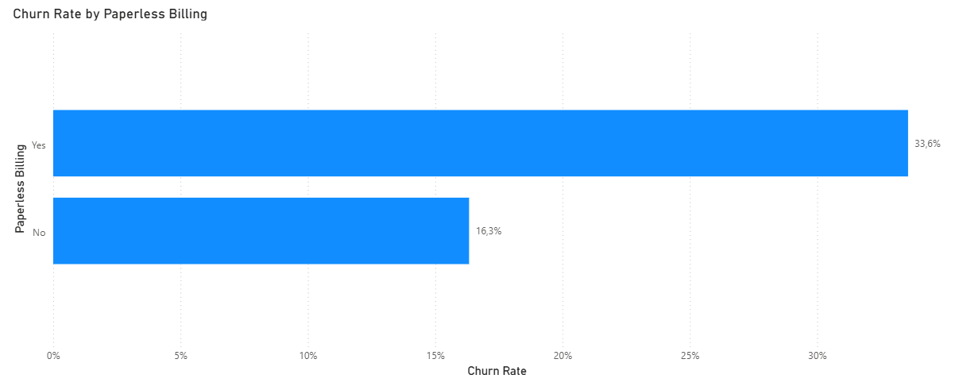
Financial & Contract Churn: PAYMENT METHOD
►The churn rate among customers with electronic bills (33.6%) is more than twice that of customers who receive paper bills (16.3%).
► Electronic bills are more often chosen by users who are digitally savvy and less tied to a specific provider, as well as by customers
with high-tier plans (Fiber Optic). Paper bills are issued to customers who are more likely to remain with the provider long-term.
► The payment method is directly correlated with churn:
► The highest churn rates are observed for payment by check (Mailed Check — 36.9%) and bank withdrawal (Bank Withdrawal — 34.0%).
► Linking a credit card reduces churn by more than half—to 14.5%.
► Recommendation: Implement automatic credit card payments as the preferred payment method (for example, offer a small bonus for linking a card).

Slide 8
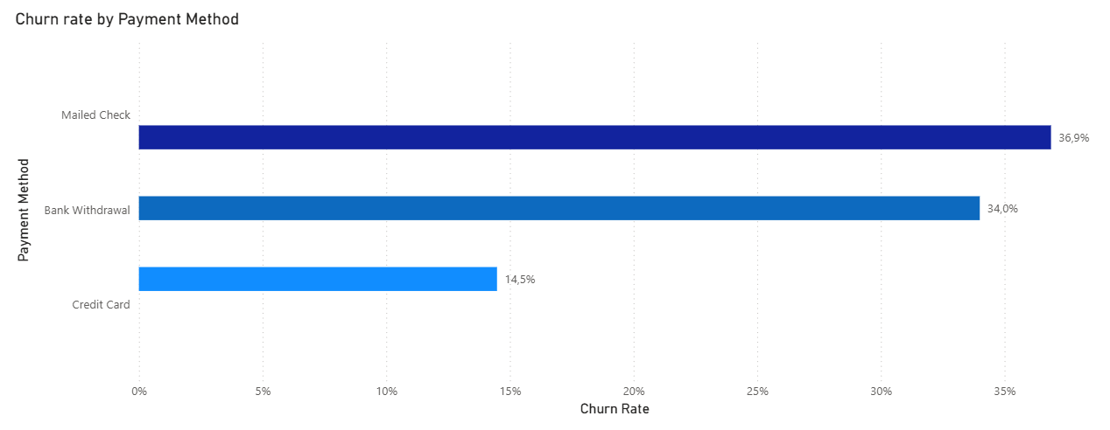
Financial & Contract Churn: PAPERLESS BILLING
► Churned customers: The average check is $74.44 (median $79.65).
► Retained customers: The average check is $62.98 (median $66.45).
►The churn rate among customers with electronic bills (33.6%) is more than twice that of customers who receive paper bills (16.3%).
► Electronic bills are more often chosen by users who are digitally savvy and less tied to a specific provider, as well as by customers
with high-tier plans (Fiber Optic). Paper bills are issued to customers who are more likely to remain with the provider long-term.

Slide 9
Financial & Contract Churn: MONTHLY CHARGES (CHURNED VS STAYED)
► Every month, the company loses $139,100 in recurring revenue due to the churn of these 1,869 customers.
This is pure lost revenue that goes directly to competitors.
► $1,669,570.20 per year (Lost Annual Run Rate)
Key point: If nothing changes, losing these customers costs the company nearly $1.67 million annually!
Why this analysis was conducted: Even if the retention strategy you’ve developed (for example, discounts for annual contracts or the inclusion
of free technical support) helps retain at least 20%–30% of churning customers, the company will save between $330,000 and $500,000 per year.
► Over the entire period of operation, lost customers have already generated $3.68 million.
These were LTV-generating customers (high average transaction value of $74.44) who used the services for a long time but at some point
encountered a problem (for example, with the quality of the fiber-optic service) and left.
► Churned customers: The average check is $74.44 (median $79.65).
► Retained customers: The average check is $62.98 (median $66.45).
Lost ARR
(Annual Run Rate):
$1 669 570.20
Lost MRR
(Monthly Revenue):
$139 130.85
Total Lost Revenue:
$3 684 459.82

Slide 10
ACTUAL AMOUNTS OF FINANCIAL LOSSES (LOST REVENUE)
THANK YOU FOR YOUR ATTENTION
► Every month, the company loses $139,100 in recurring revenue due to the churn of these 1,869 customers.
This is pure lost revenue that goes directly to competitors.
► $1,669,570.20 per year (Lost Annual Run Rate)
Key point: If nothing changes, losing these customers costs the company nearly $1.67 million annually!
Why this analysis was conducted: Even if the retention strategy you’ve developed (for example, discounts for annual contracts or the inclusion
of free technical support) helps retain at least 20%–30% of churning customers, the company will save between $330,000 and $500,000 per year.
► Over the entire period of operation, lost customers have already generated $3.68 million.
These were LTV-generating customers (high average transaction value of $74.44) who used the services for a long time but at some point
encountered a problem (for example, with the quality of the fiber-optic service) and left.
Lost ARR
(Annual Run Rate):
$1 669 570.20
Lost MRR
(Monthly Revenue):
$139 130.85
Total Lost Revenue:
$3 684 459.82

Slide 11
THANK YOU FOR YOUR ATTENTION

